Slide 1
Big Data Technology final project
Car data Analyzer (static data set)
Submitted To: Prof. Mrudula Mukadam
Submitted By:
Mateus Sergio Olivio Jose (614241)
Khadananda KC (614181)
Md Regaul Karim (614595)

Slide 2
Technologies Used
CentOS Version 6.7
Hadoop Version 2.7.7
Java JDK & JRE Version 8
Eclipse Version LUNA 4.4.2
Kafka Version 3.5.0
HBase Version 1.2.12
Spark Version 3.5.0
Impala 2.10.0

Slide 3






Project Overview
We used a static data set as a data to analyze. It’s a csv data downloaded from the provided link.
This csv file is read by a Producer(java program) and events are produced to the kafka topic (“new car”).
On receiver side, these kafka events are consumed and Spark Streaming is used to stream those events.
We have done an analysis to find the number of cars made locally(in USA) in 2018 above.
We also done another analysis to filter just the cars with less than 100,000 miles
Then the result is sent to Hbase.

Slide 4
Process flow-chart
Static data(CSV)
Kafka producer Application
Spark streaming Application
HBase
Kafka consumer Application
Read static data Application
Kafka Topic
Notes:
1.First we will get the data from twitter and store it in the Kafka Logs
2.Now from Kafka logs, we will use Spark Streaming to store the data in the HBase tables(Perform some aggregation)
3.Now we will read the data stored in Hbase table and using Spark SQL we will store the it HDFS.
4.Now we will create External Hive table using location where the csv file stored in HDFS
5.Now connect Hive to Tableau and visualize.

Slide 5

Commands used for kafka.
Install Kafka on the Cloudera: download the kafka and move to cloudera
Start kafka server- bin/kafka-server-start.sh config/server.properties
Create a topic- bin/kafka-topics.sh --create --topic newCar --bootstrap-server localhost:9092

Slide 6
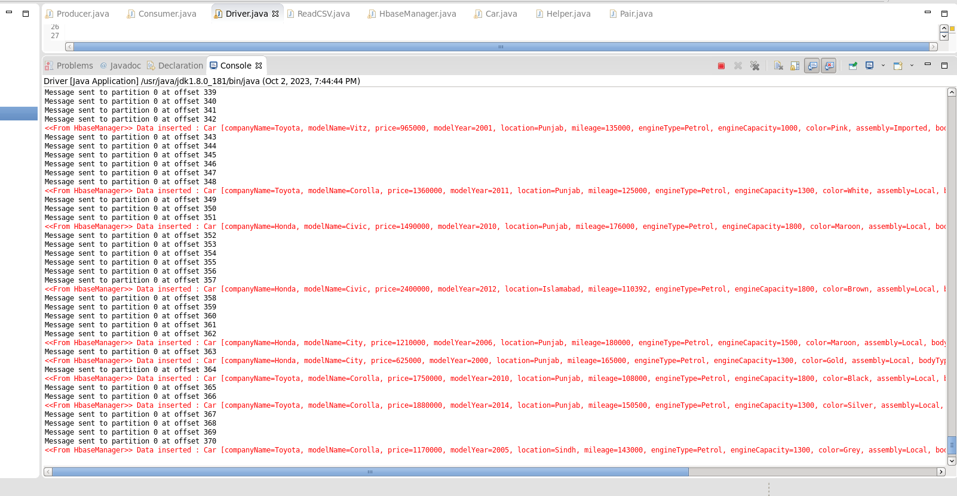
Eclipse console Producer and Consumer

Slide 7
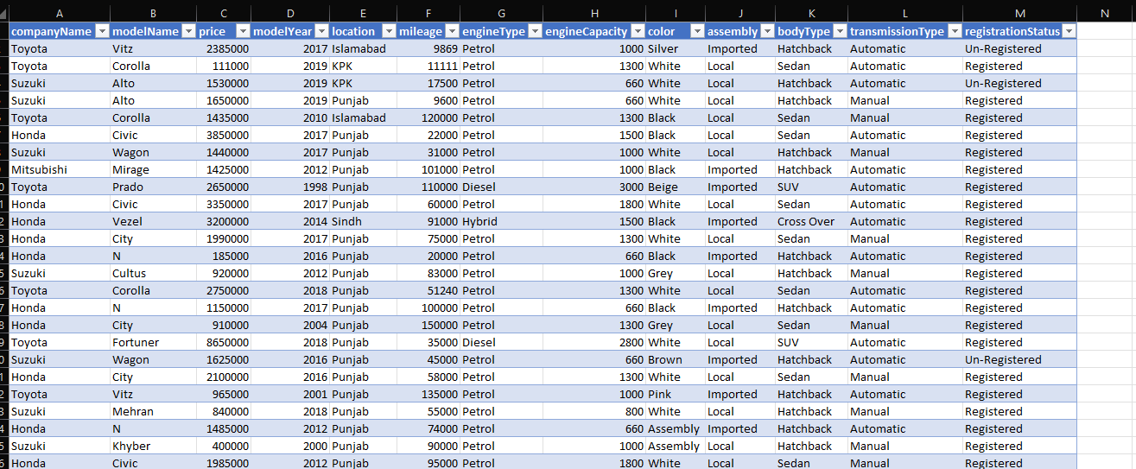
CSV Data

Slide 8
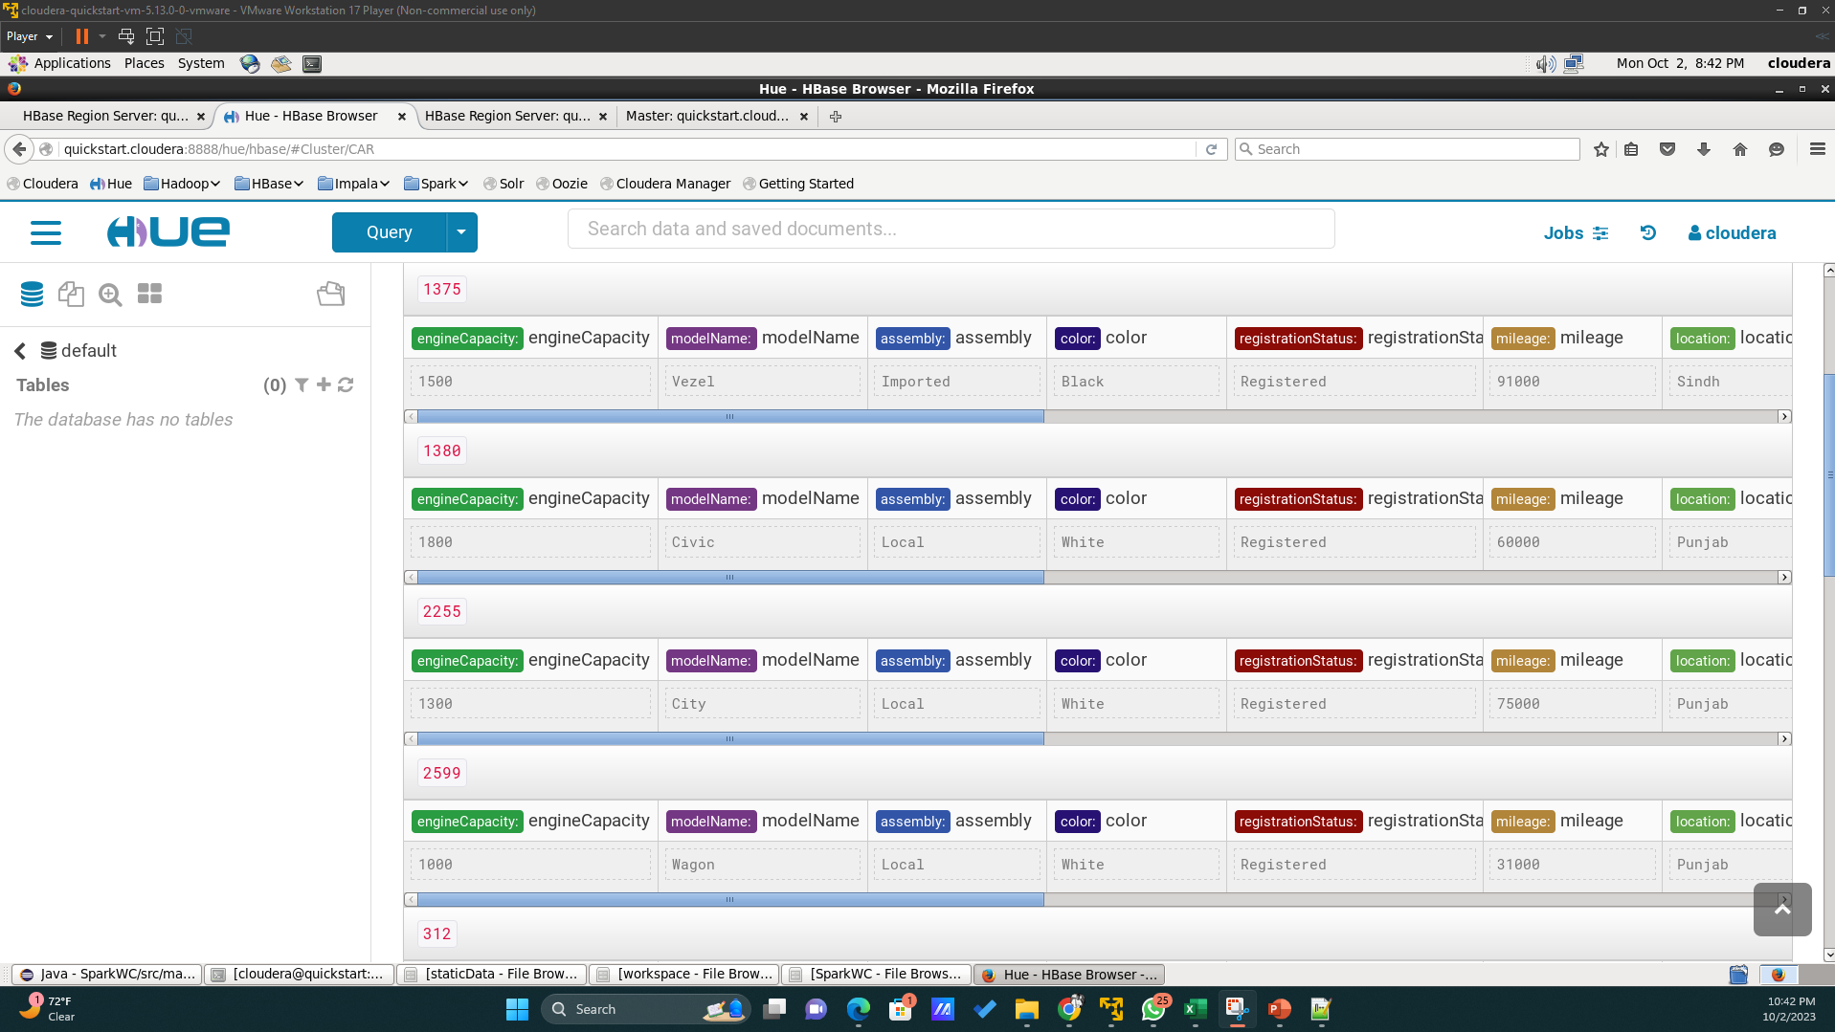
Hbase output table screen-shot

Slide 9
Thank you

